Slide 1

INSURANCE ANALYTICS
Presented By Group-4 :-
Dnyaneshwari Mohod
Radha raman jha
Syed mohammad pasha
Md sadiq
Talluri anajaneya
Dipali shanideo
Trinadh nuthalapathi

Slide 2
Project Summary
Objective:
Enhance insurance operations through BI tools for deeper insights, optimized decision-making, and improved efficiency.
Scope:
Data Integration: Consolidate diverse data sources.
Data Modeling: Develop robust models for key metrics.
Dashboards and Reports: Real-time insights for stakeholders.
Predictive Analytics: Implement machine learning for risk assessment.
User Training: Ensure proficiency in BI tool usage.

Slide 3
An insurance analytics project typically involves the application of data analysis, statistical modeling, and business intelligence tools to gain insights into various aspects of the insurance industry.
KPI List:
1-No of Invoice by Account Exec
2-Yearly Meeting Count
3.1Cross Sell--Target,Achieve,new
3.1New-Target,Achieve,new
3.1Renewal-Target, Achieve,new
4. Stage Funnel by Revenue
5. No of meeting By Account Exe
6-Top Open Opportunity

Slide 4
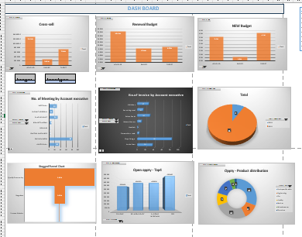
Excel Dashboard Image

Slide 5
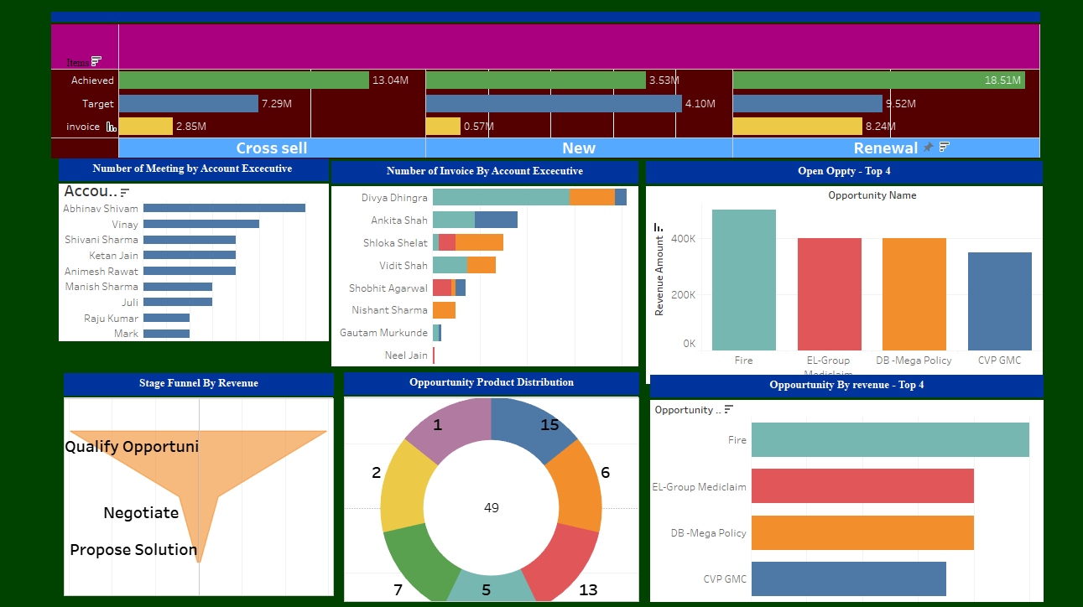
Tableau Dashboard Image

Slide 6
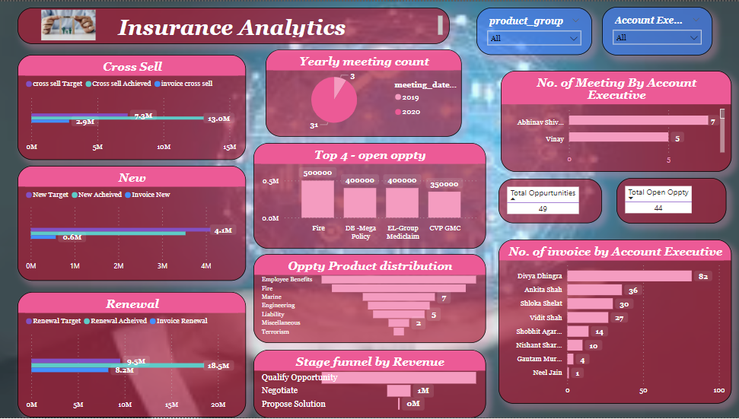
Power Bi Dashboard Image

Slide 7
Key takeaways
Quantifiable Metrics and KPIs:
Learn how to define and measure key metrics and KPIs to assess the success and impact of analytics projects.
Project Management:
Acquire project management skills specific to analytics projects, including setting realistic timelines.
Business Intelligence Tools:
Learn how to use business intelligence tools for creating interactive dashboards and reports. Understand the visualization of key performance indicators (KPIs) for different stakeholders.

Slide 8
Continuous Improvement:
Learn the importance of continuous monitoring, feedback, and adaptation in analytics projects.
.Statistical Analysis:
Gain proficiency in statistical analysis methods to extract meaningful insights from insurance data.
Data Cleaning and Preprocessing:
Learn techniques to clean and preprocess data, ensuring that it is accurate, consistent, and suitable for analysis.

Slide 9


